Slide 1

ICT in Banking
(Information & Communication Technology in the Banking Sector)
Presented by: Subhan Ghafoor
Roll no ~ 25F-CY-063

Slide 2

What is ICT?
ICT stands for Information & Communication Technology.
It includes computers, internet, software, mobile communication, and digital networks.
Purpose: Store, process, and exchange information digitally.

Slide 3

ICT in Banking
Use of digital technology to perform banking operations efficiently and securely.
Helps banks to deliver fast, accurate, and convenient services.
Makes banking paperless and automated.

Slide 4
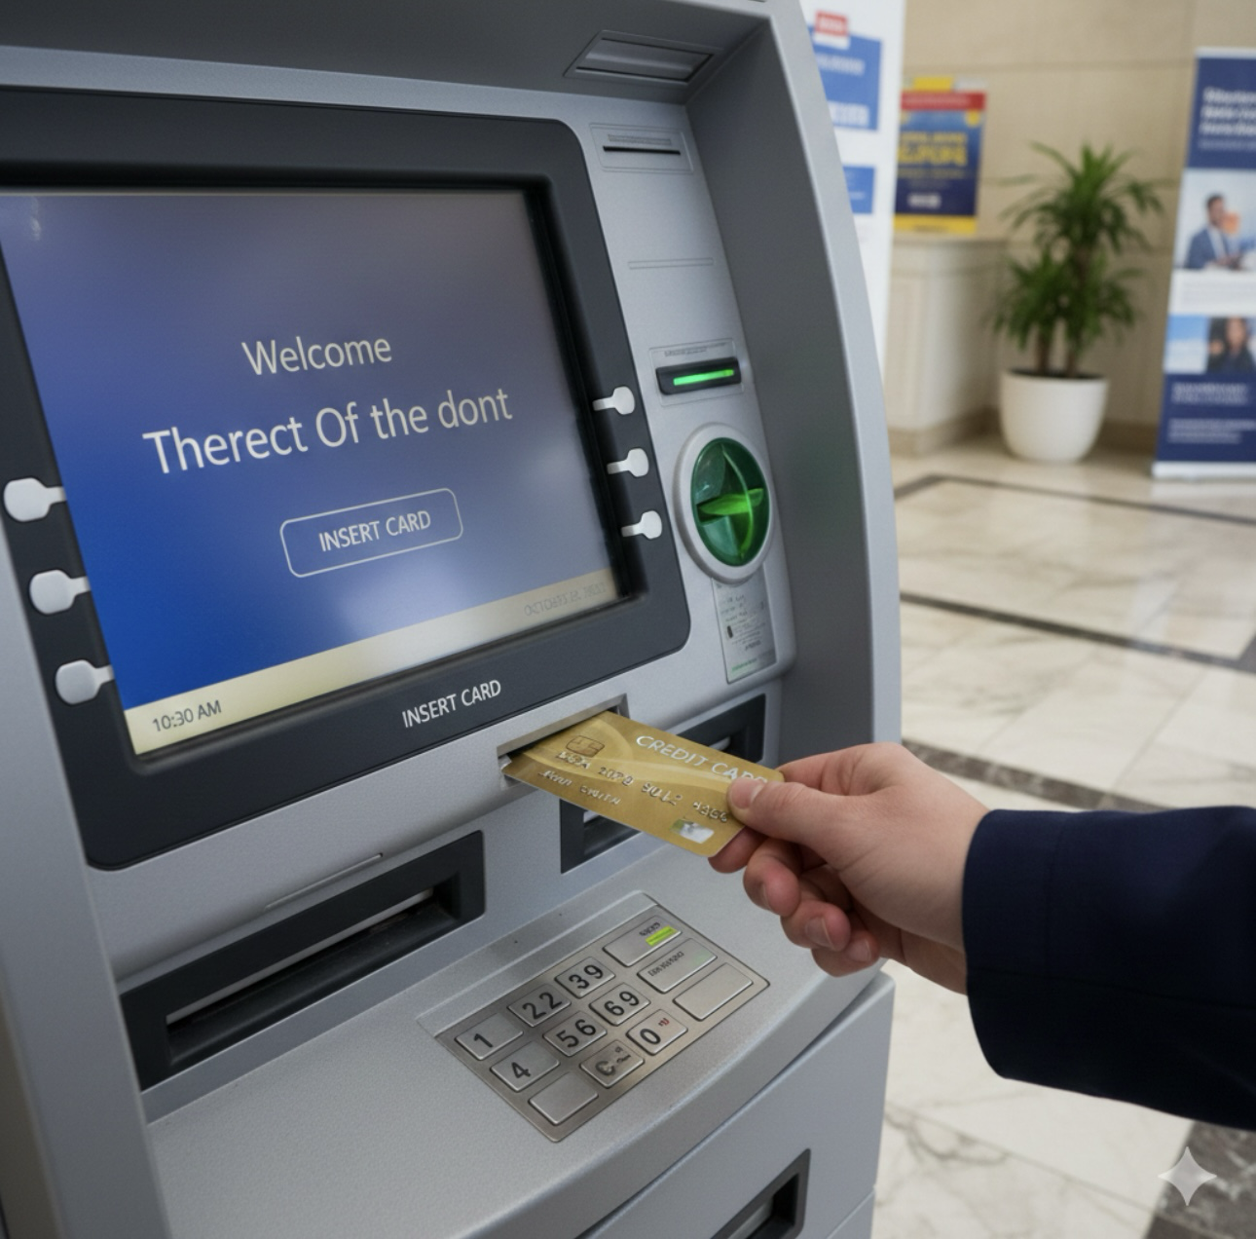
Key ICT Banking Services
ATM (Automated Teller Machine).
Online Banking.
Mobile Banking Apps.
Credit/Debit Cards.
Electronic Fund Transfer (EFT).
SMS Alerts & Notifications.
Cloud data management.

Slide 5
Examples of ICT Tools in Banking
Tool / Service Purpose
ATM Cash withdraw anytime
Mobile Apps Banking through phone
Internet Banking Online transactions
Debit/Credit Card Digital payment
SMS Alert Transaction updates

Slide 6
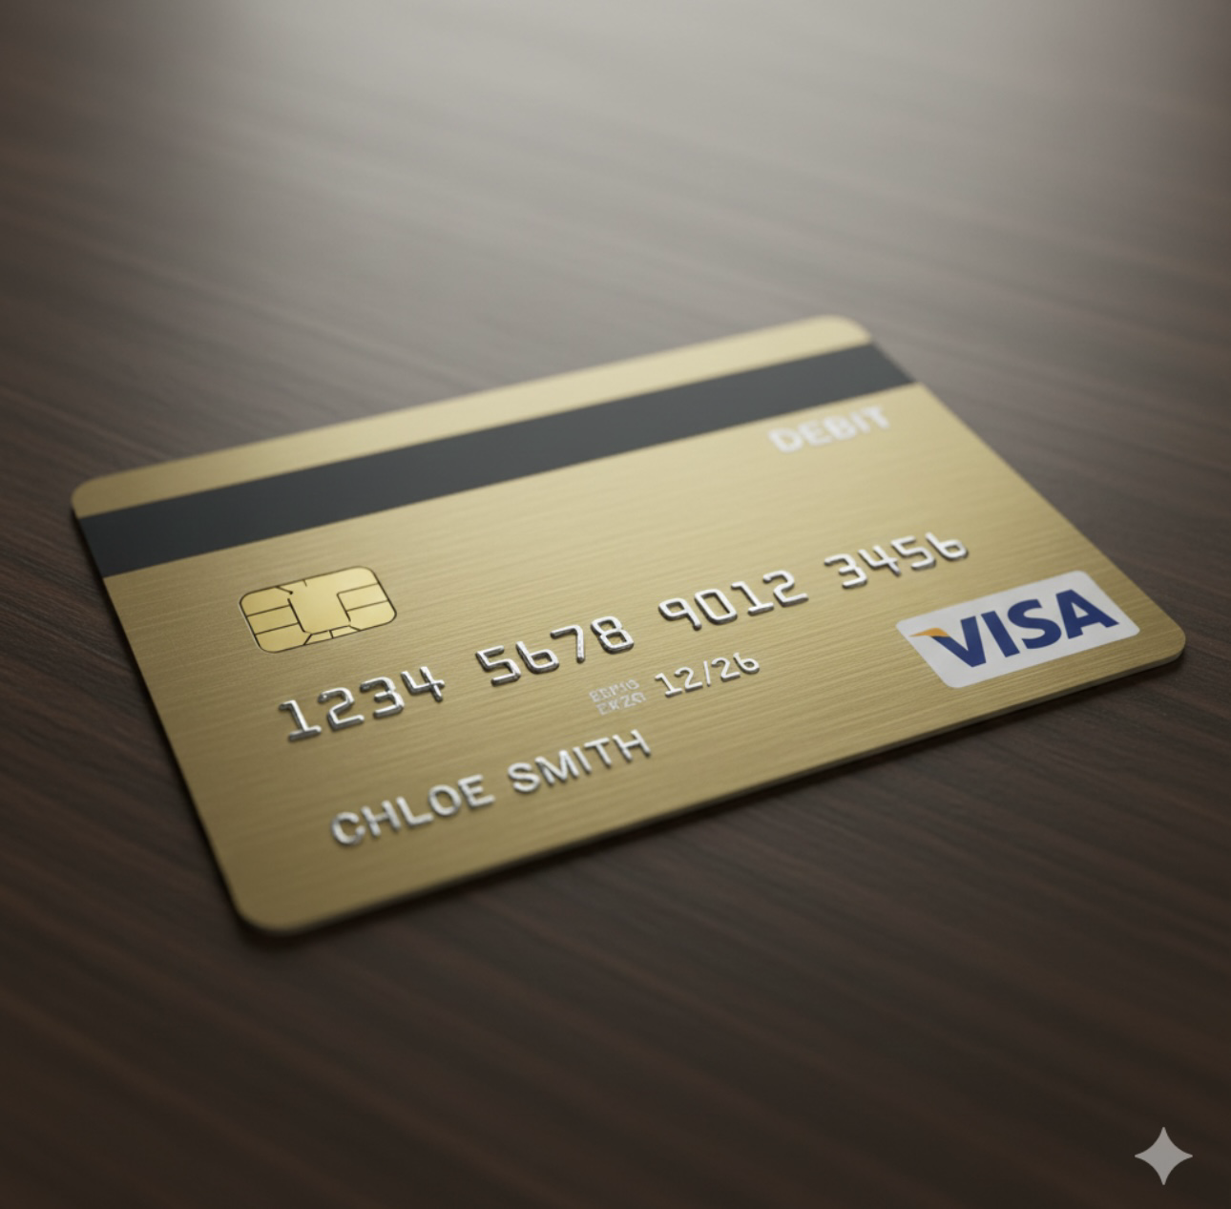
Security in ICT Banking
Two-Factor Authentication (2FA).
Biometric verification (fingerprint, face ID).
Firewalls & Antivirus.
Encrypted transactions.
Secure servers & cloud backup.

Slide 7
Advantages of ICT in banking
24/7 Accessibility: Unlike traditional banking hours, ICT allows customers to access their funds, pay bills, and transfer money at any time through ATMs, mobile apps, and online portals.
Lower Transaction Costs: Banks save significant overhead by reducing physical branch maintenance.
Speed and Efficiency: Complex processes that once took days—such as clearing checks or domestic wire transfers—now happen instantly or within hours due to automated digital clearance systems.

Slide 8
Disadvantages of ICT in Banking
Security Risks & Cybercrime: The reliance on digital networks exposes banks and customers to phishing, hacking, and identity theft.
Job Displacement: The rise of automation and self-service kiosks (like ATMs and AI chatbots) has led to a decrease in the demand for bank tellers and administrative staff, leading to unemployment in the sector.

Slide 9
THANK YOU

